Slide 1

First-cry Demo Application
Real life lab (rll)
Group 1

Slide 2
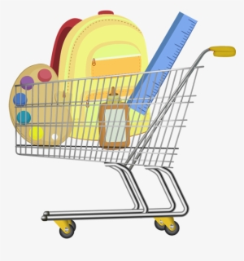
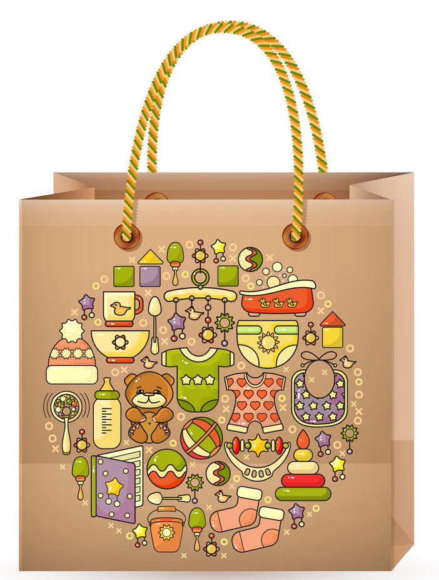
TEAM MEMBERS
Rithik Richard (2580662)
Anjali Upadhyay (2580446)
Rahul Kumar (2580325)
Chandaluru Nandakishore (2580039)
Chappidi Naresh (2579957)
Chilukuri Ganesh (2580169)
Santhosh K (2580152)
Sabbella Urmila (2580212)

Slide 3

CONTENT
Introduction
Test Scenarios
Feature File
Gherkin Keyword
Technologies
Screenshot
Outcome
Conclusion

Slide 4
INTRODUCTION
FirstCry.com is India’s largest E-Commerce dedicated to new Mothers and Babies.
FirstCry is a one stop shop for all baby needs.
The website has various features integrated to make customer shopping hassle free.
Some of the features included are Search bar, Cart, Shortlist, FindStore & Pre-School feature.

Slide 5
TEST SCENARIOS

Slide 6
TEST SCENARIOS
What is Test Scenario?
A test scenario is a concise description of a specific condition or event to be tested in software testing.
In other words, it describes an action the user may undertake with a website.
Functionalities:
Log In : - Navigate to the URL, Enter the Credentials , and click on the login.
MyProfile : - Navigate to the URL, login into the application. Click on the Home > My Account > My Profile. Perform the Edit Operation.
Search : - Navigate to the URL, login into the application. Search for any product.

Slide 7
TEST SCENARIOS
AddToCart : - Navigate to the URL, login into the application. Search for any product from the search result to the cart.
Store Locator : - Navigate to the URL, login into the application. Click on the Stores & Preschools >> Find Store.
Preschool Locator : - Navigate to the URL, login into the application. Click on the Stores & Preschools >> Find Preschool Locator.
Cart Functionaity : - Navigate to the URL, login into the application. Click on the cart after adding products, Perform all operations in cart
Shortlist : - Navigate to the URL, login into the application. Click on the shortlist after shortlisting few product. Perform all operation in Shortlist.

Slide 8
FEATURE FILE

Slide 9
FEATURE FILE
The feature file serves as a collaboration tool between the business stakeholders, developers, and testers. It helps to bridge the gap between technical and non-technical team members by providing a common language to describe the expected behavior of the software.
Feature files typically use the Gherkin language,which is a plian-text language with a specific syntax for describing the behaviour of software systems.Gherkin is designed to be easily Readable.
A feature file is usually named with a ".feature" extension and contains scenarios that represent different aspects of the system's behavior. The structure of a feature file includes the following elements:
Feature: Describes a high-level feature or functionality of the software system.
Scenario: Describes a specific scenario or test case related to the feature.

Slide 10
FEATURE FILE
Steps: Describe the steps that should be taken to perform the scenario. Steps are written in a given-when-then format.
Behavior-Driven Development (BDD): Feature files are a core component of the BDD approach, where the focus is on defining the desired behavior of the software through collaboration and communication. BDD emphasizes the use of feature files to drive development and testing activities.
It can be used as executable specifications, where the steps defined in the feature file are implemented as automated tests. Tools like Cucumber, Behave, it can interpret feature files and execute the corresponding tests in a behavior-driven development framework. This allows teams to ensure that the software behaves as expected based on the specifications outlined in the feature files.

Slide 11
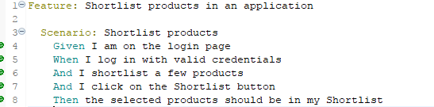
FEATURE FILE
The Example of Feature File is in below:
Fig 1

Slide 12
ITESTLISTENERS
‘ITestListener’ is used to listen the various events during execuation of your test suite.It provides a way to perform actions Based on different Events. ITestListener is an interface implemented in the class, and that class overrides the ITestListener-defined methods. The ITestListener listens to the desired events and executes the methods accordingly.
This is the most frequently used TestNG listener. ITestListener is an interface implemented in the class, and that class overrides the ITestListener-defined methods. The ITestListener listens to the desired events and executes the methods accordingly.
It contains the following ways:
onTestStart: This method is invoked when a test method is about to start.
onTestSuccess(): invoked on the success of a test.

Slide 13
ITESTLISTENERS
onTestFailure(): invoked on the failure of a test.
onTestSkipped(): invoked when a test is skipped.
onStart(): This method is invoked before any test starts.
onFinish(): This method is invoked after all tests have run. The above-mentioned methods use the parameters ITestContext and ITestResult.
ITestContext: The ITestContext is a class that contains information about the test run.
ITestResult: The ITestResult is an interface that defines the result of the test.
onTestFailedButWithinSuccessPercentage: Method is called each time Test fails but is within success percentage.

Slide 14
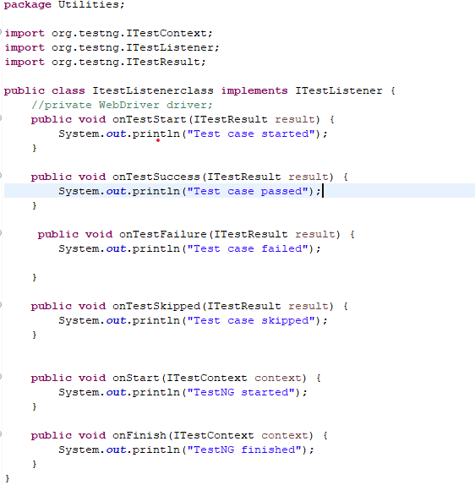
EXAMPLE OF ITESTLISTENER
FIG 02

Slide 15
GHERKIN KEYWORKS

Slide 16
INTRODUCTION TO GHERKIN & BEHAVIOR-DRIVEN DEVELOPMENT
Explanation of BDD: A collaborative approach to software development that integrates business stakeholders with the development team.
Role of Gherkin in BDD: Behaviour using plain language. Facilitates clear communication of software
Benefits of using Gherkin: Enhances clarity, improves stakeholder engagement, and streamlines the development process.
Test Automation Alignment: Gherkin syntax pairs with tools like Cucumber to convert behavior descriptions into automated tests, enhancing test coverage and reliability.
Living Documentation: Gherkin scenarios double as documentation, keeping team members and stakeholders aligned with the current functionalities of the system.

Slide 17
OVERVIEW OF GHERKIN LANGUAGE
Nature of Gherkin: A domain-specific language for writing structured yet natural language specifications.
Structure of a Gherkin Document: Explaining Features, Scenarios, Steps, and Background.
Importance of Gherkin's readability: Ensuring that documentation is accessible to all stakeholders.
Enables Behavior Validation: Gherkin allows the validation of application behavior against business requirements, ensuring software acts as expected.
Facilitates Collaboration: By using language everyone understands, Gherkin fosters better collaboration between developers, testers, and business stakeholders.

Slide 18
GHERKIN KEYWORDS – ‘FEATURE’ AND ‘SCENARIO’
Feature: A 'Feature' in Gherkin provides a high-level description of a software feature, outlining its business value and purpose. It starts with the keyword 'Feature', followed by a title and a brief narrative that sets the context for the Scenarios that follow. For example, "Feature: Login Functionality" describes the overall intention and benefit of the login feature.
Scenario: A 'Scenario' is a specific example that demonstrates how the software behaves under certain conditions. It begins with the keyword 'Scenario', followed by a descriptive title and a series of steps using Gherkin's 'Given', 'When', 'Then' structure to define preconditions, actions, and expected outcomes. For instance, a scenario titled "Successful login with valid credentials" would detail the steps and expected result of a user logging in successfully.

Slide 19
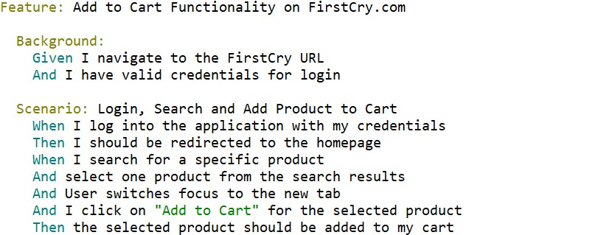
GHERKIN KEYWORDS - 'Given', 'When', 'Then'
Given: Setting the scene or context for the scenario.
When: Describing the key action or event.
Then: Outlining the expected result or state.
FIG 03

Slide 20
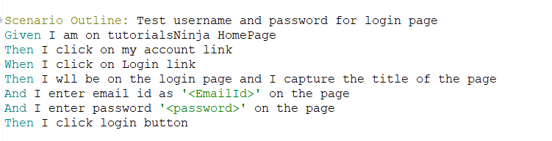
Gherkin Keywords - 'And', 'But'
And: Use for adding additional conditions or actions.
But: Employed for specifying an exception or negative condition.
FIG 04

Slide 21
TECHNOLOGY

Slide 22
INTRODUCTION OF TECHNOLOGY
Introduction of what all technology’s we have used in this project
Cucmber: Cucumber uses a plain-text format called Gherkin to define these scenarios, making it readable and understandable by everyone involved in the software development process.
Selenium: Selenium can be easily integrated with popular testing frameworks such as JUnit, TestNG, and NUnit, providing additional features for test management and reporting.
Listeners: listener is a mechanism that allows you to capture and respond to events during test execution.
TestNG: TestNG provides annotations to define test methods, supports parameterization, and allows grouping and prioritizing tests.

Slide 23
SELENIUM
Selenium is an open-source framework used for automating web browsers.
It provides a set of tools and libraries that allow testers to interact with web elements, perform actions, and verify expected results.
Selenium supports various programming languages like Java, Python, C#, and more.
Features:
Browser Automation
Testing Framework Integration
Overall, Selenium is widely employed for web testing, ensuring the reliability and efficiency of web applications across various browsers.

Slide 24
LISTENERS
Listeners are basically the ones who have the ability to listen to a particular event.
It is defined as an interface that modifies the behavior of the system.
Listeners allow customization of reports and logs.
Listeners mainly comprise of two types, namely:
WebDriver listeners: WebDriver listeners in Selenium are event listeners that allow you to listen to events emitted by the WebDriver.
TestNG listeners: TestNG listeners in Selenium to perform operations before and after we execute a test method.

Slide 25
CUCUMBER
Cucumber is a tool that supports Behaviour-Driven Development(BDD).
Cucumber provides a way for software teams to define, execute, and automate functional tests written in a natural Language format.
Cucumber uses a syntax called “Gherkin”.
It is a specific language used in the context of Behaviour-Driven Development (BDD) to describe the behaviour of software.
Behavior Driven Development (BDD): Cucumber promotes BDD by allowing teams to write specifications in a human-readable format, making collaboration easier.
Cucumber helps bridge the communication gap between technical and non-technical team members by allowing tests to be written in a natural language format.

Slide 26
TESTNG
TestNG (Test Next Generation) is a testing framework inspired by JUnit and NUnit, designed for simplifying test configuration and parallel execution.
Developed by Cédric Beust, TestNG offers powerful features for testing Java applications and provides a more flexible and easily configurable testing environment.
The design goal of TestNG is to cover a wider range of test categories: unit, functional, end-to-end, integration, etc.,
TestNG supports parallel test execution, test configuration through annotations, data-driven testing, and comprehensive test reporting.

Slide 27
POM(PAGE OBJECT MODEL)
POM (Project Object Model) file is an XML file used in Maven based Java projects.
It is a design pattern commonly used in Selenium automation testing to enhance the maintainability and reusability of test code.
Components representing the pages of the application, encapsulating the interactions and elements on each page.
Methods in the test code that interact with the Page Objects to perform actions and validations.
The Page Object class encapsulates the elements and methods related to that specific page or component.

Slide 28
MOUSE HOVER
"hover over" refers to the action of moving the mouse pointer over an element on a web page without clicking it.
This is often done to trigger dropdown menus or other interactive elements that appear when the mouse hovers over a specific area.
To perform a hover over action , we can use the Actions class provided by the Selenium WebDriver.
This action can be used to reveal hidden elements that are associated with the hovered element.
By using the `move_to_element()` method from the Actions class, you can move the mouse pointer to the desired element.

Slide 29
DROPDOWN
Dropdowns are commonly used in web applications to provide a list of options for users to choose from.
Selenium provides several methods to interact with dropdowns and select or retrieve values from them.
In Selenium, a drop-down button is typically represented by an HTML <select> element. You can interact with a drop-down button using the Select class in Selenium.
Eg: Select_by_visible_text() , Select_by_value() , Select_by_index()

Slide 30
SCREENSHOT

Slide 31
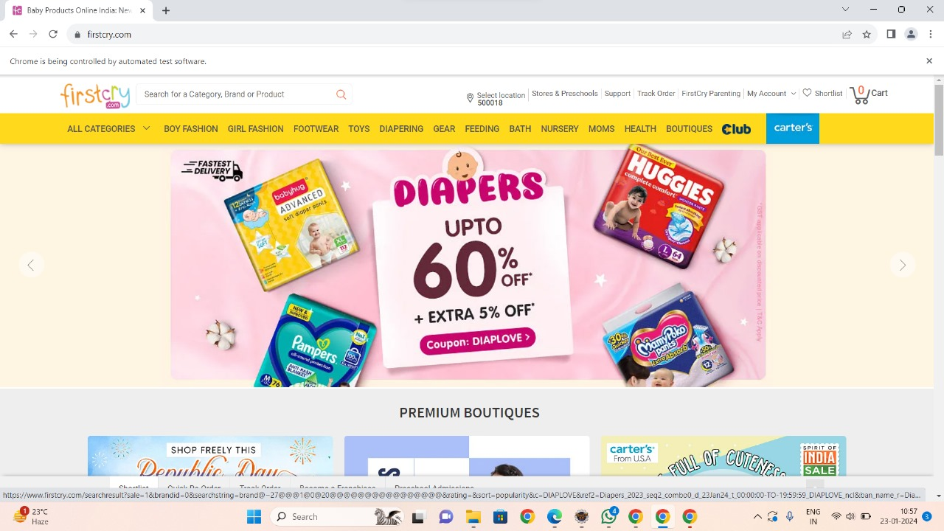
LOGIN FEATURE FILE
@firstcry
Feature: First Cry Login Automation
Scenario: Login to First Cry
Given a user is in the Landing Page on
First cry
When user click on the login button
And user enter valid Email id
And user click on the continue button
And user click the submit button
And user should be logged in successfully
Scenario: Login to First Cry
Given a user is in the landing Page
When user clicks on the Login button
And user enter invalid Email id
And user click on the continue button
And user click the submit button
And user should be not able to
logged successfully
FIG 05

Slide 32
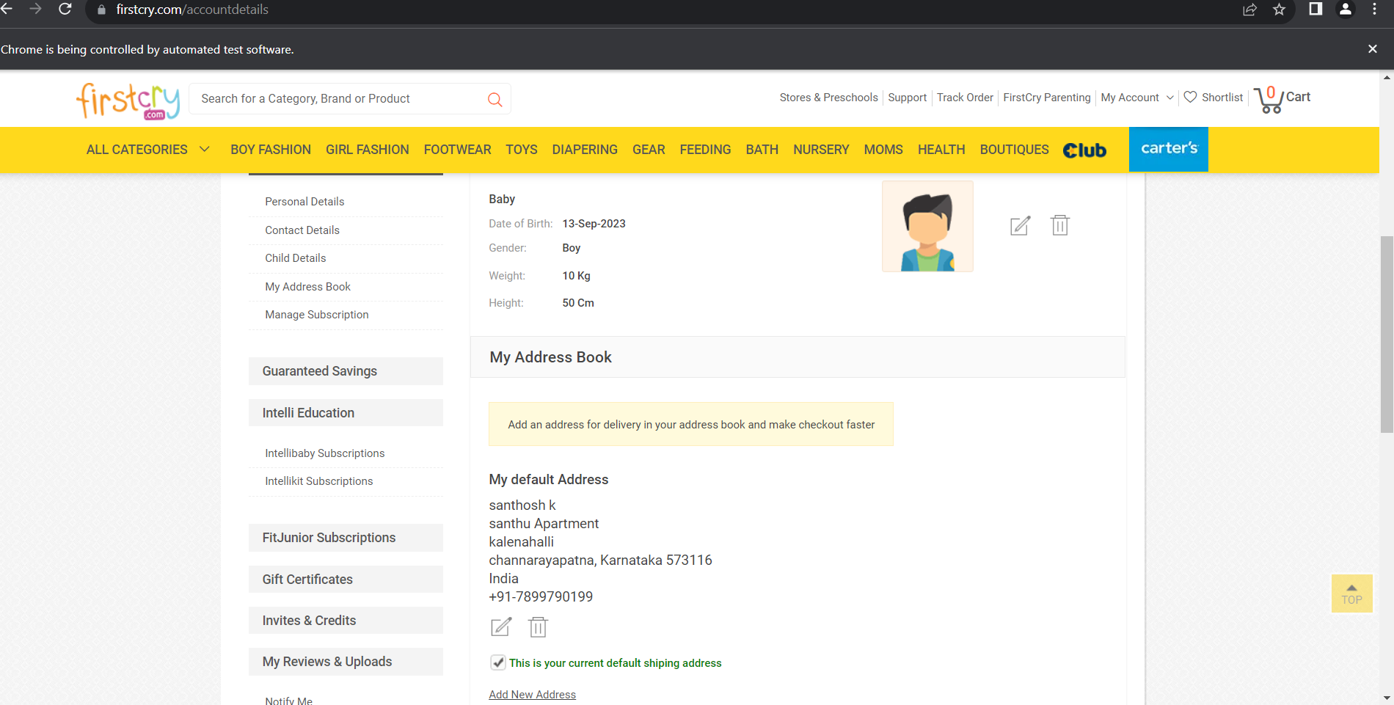
MY PROFILE FEATURE FILE
@firstcry
Feature: My Profile Functionality
Scenario: User edits their profile information
Given I open the browser
When I navigate to the application
When I Log in with valid credentials
When I click on My Account
And I select My Profile
And I perform an Edit operation
FIG 06

Slide 33
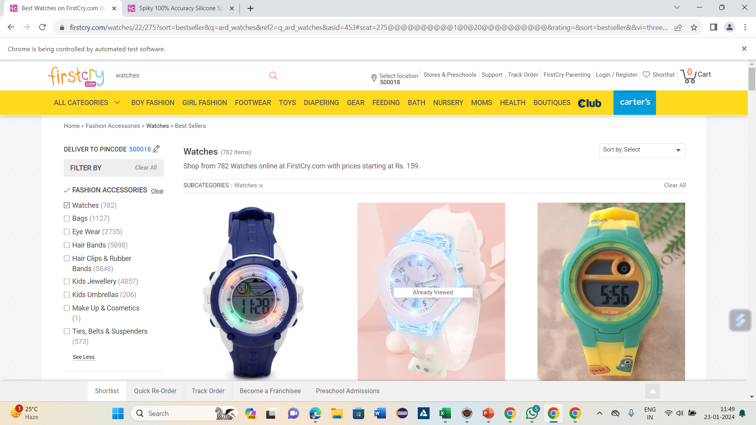
SEARCH FEATURE FILE
@firstcry
Feature: Test the Search Functionality
Background:
Given I navigate to the First cry URL
And I have valid credentials for login
Scenario Outline: Login, Search
When I log into the application with my credentials
Then I should be redirected to the homepage
When I search for a specific product
And select "<Search product>" from the search results
And User switches focus to the new tab
Then title should contain "<Search product>"
Examples:
|Search product |
|watches |
|Jackets |
FIG 07

Slide 34
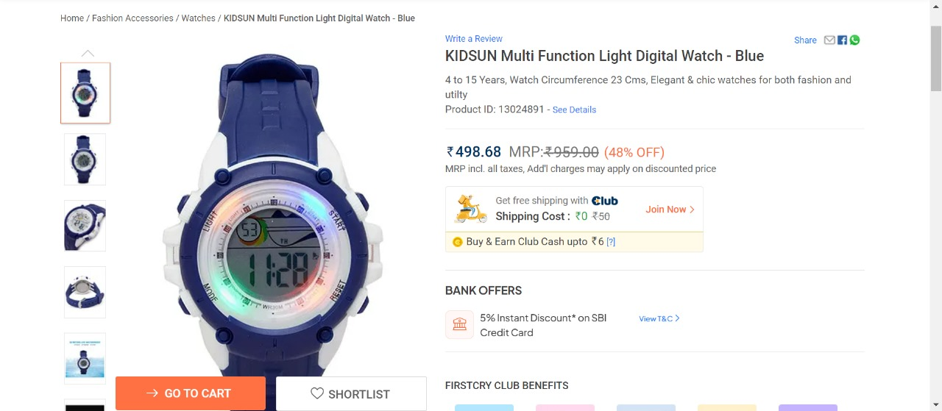
ADD TO CART FEATURE FILE
@firstcry
Feature: Add to Cart Functionality on FirstCry.com
Background:
Given I navigate to the First Cry URL
And I have valid credentials for login
Scenario: Login, Search and Add Product to Cart
When I log into the application with my credentials
Then I should be redirected to the homepage
When I search for a specific product
And select one product from the search results
And User switches focus to the new tab
And I click on "Add to Cart" for the selected product
Then the selected product should be added to my cart
FIG 08

Slide 35
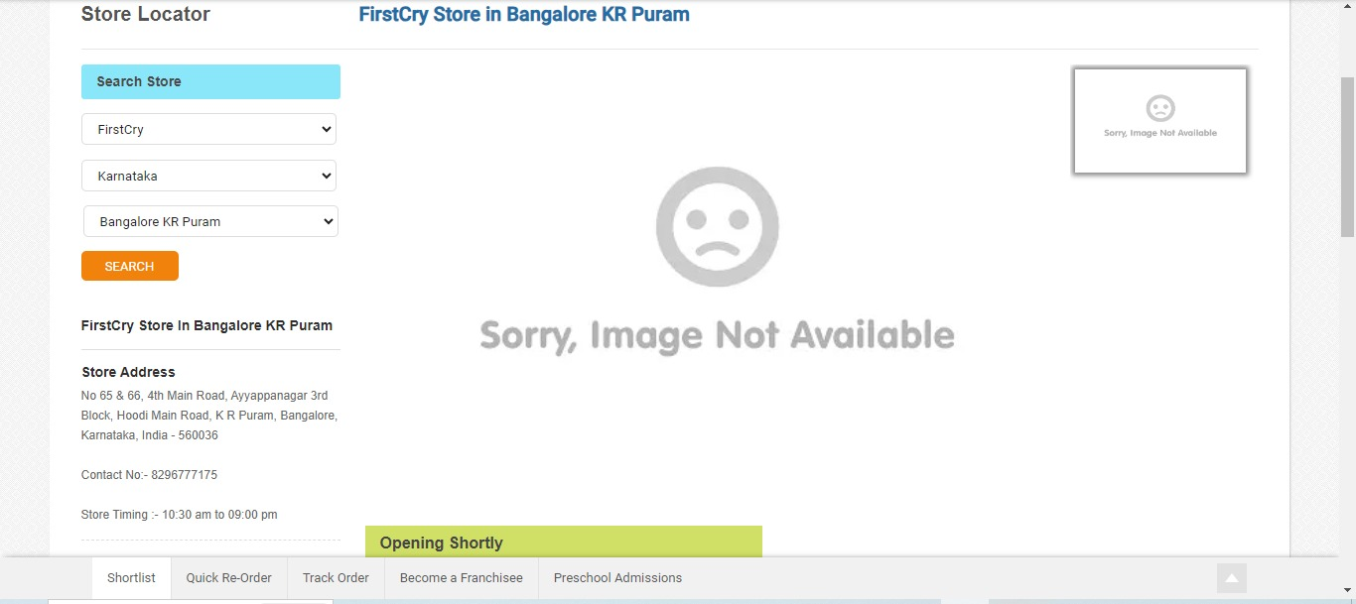
STORE LOCATOR FEATURE FILE
@firstcry
Feature: Store Locator Functionality
Background:
Given Given User navigates to the web URL
When User must click on login/Register
And User Enter the valid emailID
And User clicks on the continue button
And User Enter OTP
And User Clicks on Submit button
Then User must be able to view the store result
Scenario: User must be able to find FirstCry store results
Given User must be able to access HomePage
When User must hover over the stores&Preschool
And User must click on the findstores from drop down
And User switches focus to the new tab
And User select the store Type, state and city
And User click on the search button
Then User must be able to view the store result
FIG 09

Slide 36
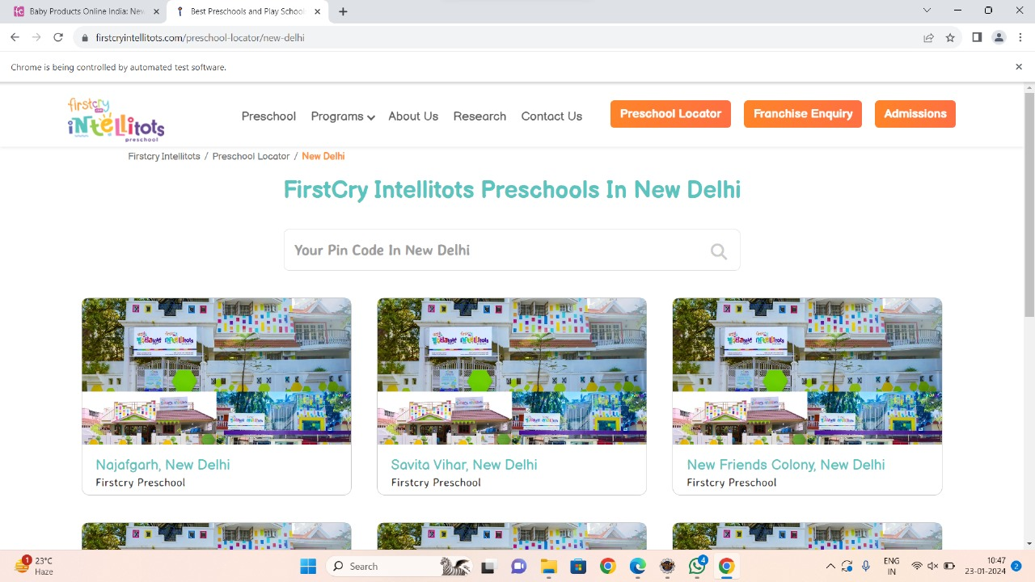
PRE SCHOOL LOCATOR FEATURE FILE
@firstcry
Feature: First Cry Find preschool Login Automation
Scenario: Login to First Cry
Given a user is in the Landing Page
When user click on the login button
And user enter valid email id and
And user click on the continue button
And user click the submit button
And user should be Logged In
And user can click on store and preschool
And user can click on find preschool
And user switches focus to new tab
And user clicks on the second available city
And click on find my preschool
Then user must able to verify the first cry Intellitots preschools in New Delhi
FIG 10

Slide 37
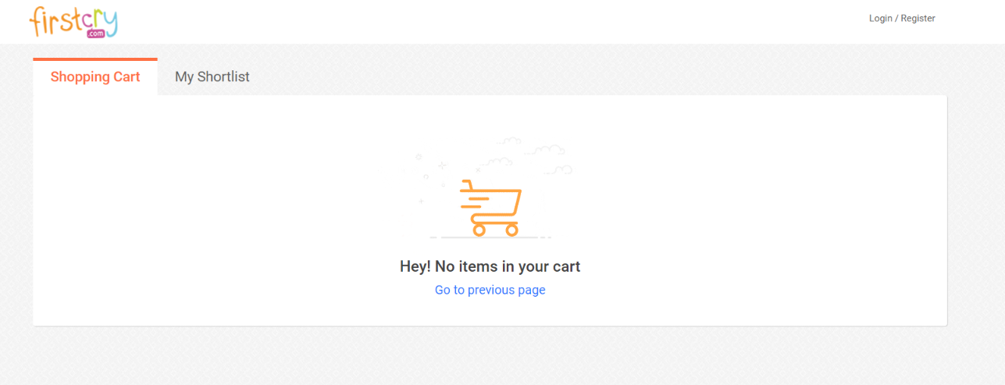
CART FEATURE FILE
@firstcry
Feature: Title of your feature
Background:
Given User navigates to the web URL
When User click on the Register
And User Enter the valid emailID
And User clicks on the continue button
And User Clicks on Submit button
Then Validate login is successful
Scenario:
When User goto Search button
And User select the product
And go to the add to cart button
And go to the Go to cart button
And increase the Quality of the product
Then Remove the product from the cart
FIG 11

Slide 38
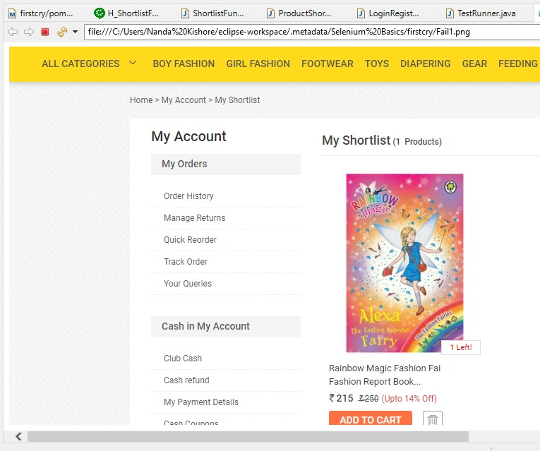
SHORTLIST FEATURE FILE
@firstcry
Feature: Shortlist products in an application
Scenario: Shortlist products
Given I am on the login page
When I log in with valid credentials
And I shortlist a few products
And I click on the Shortlist button
Then the selected products should be in my Shortlist
FIG 12

Slide 39
OUTCOME

Slide 40
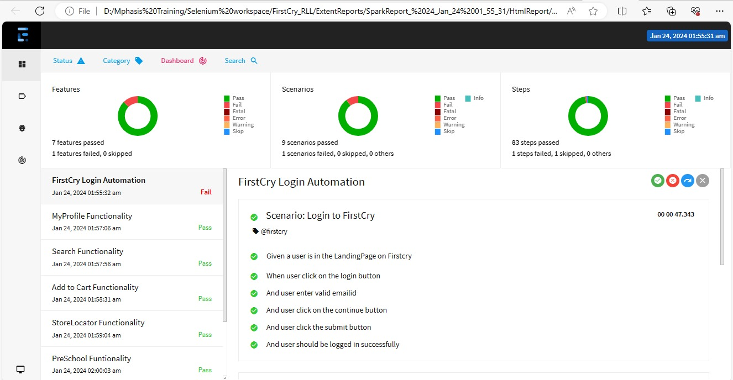
EXTENT REPORT
FIG 13

Slide 41
ADVANTAGES OF AUTOMATION TESTING
Efficiency and Speed : Automated tests can be executed significantly faster than manual tests..
Reusability of Test Scripts : Once test scripts are developed, they can be reused across different versions of the software or in different projects, saving time and effort.
Parallel Execution : Automation tools allow the execution of multiple test scripts simultaneously.
Improved Accuracy : Automated tests eliminate the possibility of human errors in test execution. Tests are performed precisely as programmed, ensuring more accurate and reliable results.

Slide 42
DISADVANTAGES OF AUTOMATION TESTING
High Initial Investment : Setting up an automated testing environment requires a significant investment in terms of tools, resources, and skilled personnel.
Scripting Skills Required : Automated testing involves the creation of scripts, and testers need to have scripting skills.
Limited Testing for User Experience : Automated tests are generally focused on functional aspects and may not effectively test the user experience, usability, or subjective aspects of the software.
Maintenance Challenges : As the application evolves, the automated test scripts need to be maintained and updated.

Slide 43
CONCLUSION
The project met the specified requirements and was running successfully in eclipse.
All the test scenarios are verified Including positive and negative cases
The project has successfully generated Extent reports and captured screenshots
JIRA was utilized for Test Management Lifecycle.
Here, we have merged all the test scenarios in one Git hub repository:
https://github.com/rithikrichard17/RLL_Project_FirstCry_Team1

Slide 44
THANK YOU

